Slide 1

NBA Player data and salary prediction

Slide 2
abstract
This project aims to make a number of inferences about what affects a players salary
It also compares stats of all player who play in various positions and tries to find if certain positions imply better stats.
We have created a few linear regression models to try and predict the salaries of the players.
We also plotted the evolutions of all shots and 3 point attempts through the years.

Slide 3
Data cleaning
In this dataset, cleaning was just removing null values
Ignored empty stats when they would vary the inferences we obtained.
Looked for extreme outliers but found none.

Slide 4
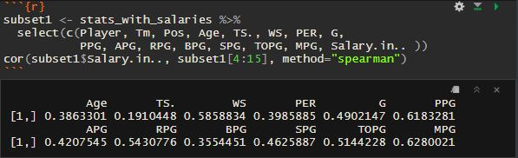
Correlation between player stats and salary
Calculated the correlation between 12 stats that could have an effect on salary.
The Points Per Game (PPG) stat was the one that showed the highest correlation to salary.
This is accurate and expected.

Slide 5
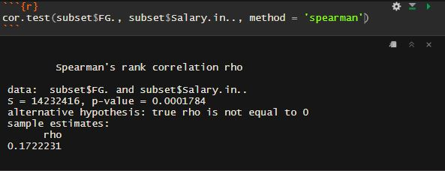
Correlation between field goal percentage and salary
The correlation doesn’t seem to be very high.
This means that being an efficient scorer does not always imply a higher salary.

Slide 6
Analysis of performance stats for different positions

Slide 7
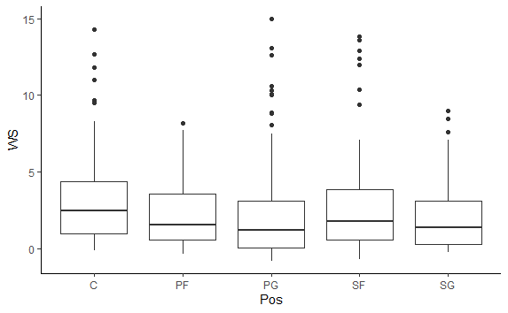
Win shares vs position
This plot shows the distribution of win shares for each position.
From the graph it can be seen that players in the Centre position have marginally the highest mean win share stat.

Slide 8
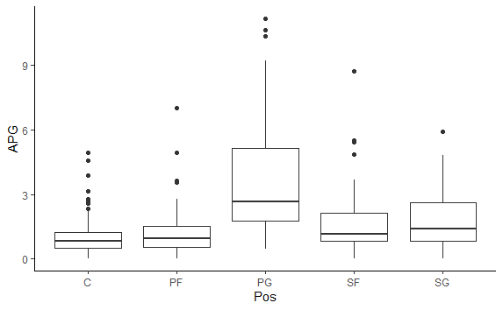
Assists per game vs position
This plot shows the distribution of Assists per game for each position.
From the graph it can be seen that players in the Point Guard position have the highest mean assists per game.

Slide 9
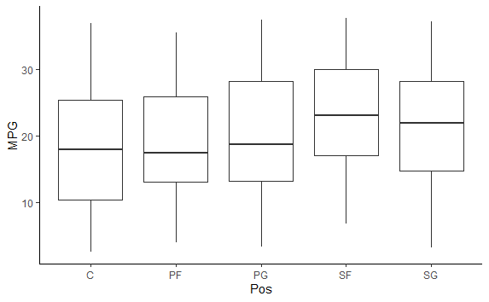
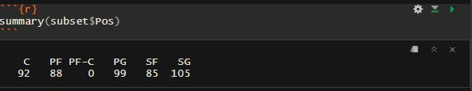
Minutes per game vs position
From the graph is it is visible that players in the Small Forward position play the most minutes per game.
On further analysis, it was observed that the number of Small Forwards was the least among all positions.
Which is a reason for them playing more Minutes Per Game

Slide 10
Salary modelling and prediction

Slide 11
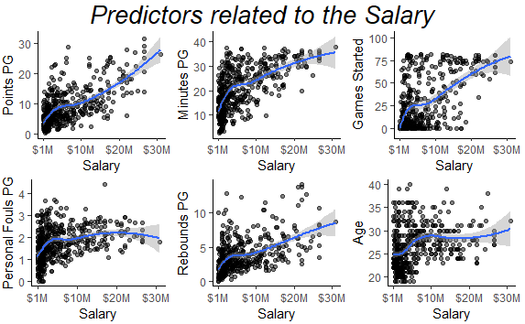
Stats and their relation to salary
Plotted six different stats and their relation to Salary the player earned.
From the graphs, we can infer that the PPG, MPG and the GS stats have clear correlation with the salary the player earns.
Keeping this in mind, we try and model the salary using Linear Regression.

Slide 12






Models used to predict the salary

Slide 13
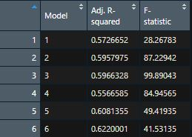
Comparing the six models
The model with the highest Adjusted R-squared would be the best model for the given data.
Model 6 seems to be the best model for Salary.

Slide 14
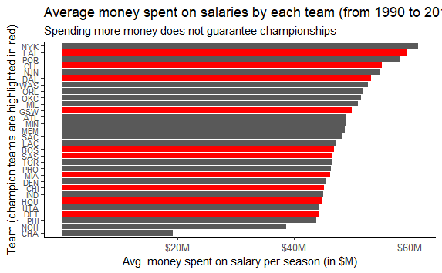
Average salary spent by each team
The New York Knicks have spent the most on average salaries per player across all seasons.
The Charlotte Hornets are the lowest spending team across all seasons.

Slide 15
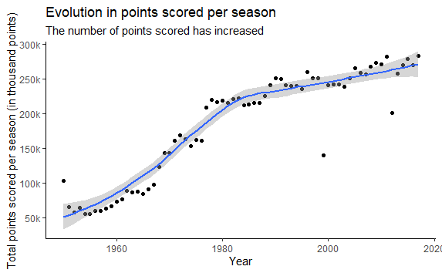
Evolution of points scored per season
We see that the points scored in the 1950 – 1985 period, has a roughly rapid increase every season.
Whereas the period from 1985 – 2018 still increases but less rapidly.

Slide 16
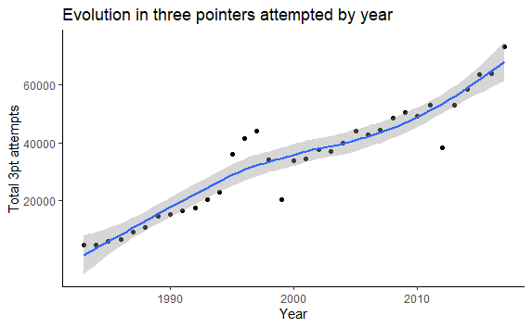
Evolution in 3 pointers attempted per year
The overall number of attempted three pointers increases every season.
With a few exceptions, the rate is constant until the 2011 season, which is when Stephen Curry starts entering his prime.

